Slide 1


SOARING DATA SOLUTIONS

Slide 2




in collaboration with

Slide 3
in collaboration with

Slide 5
sales data

Slide 7

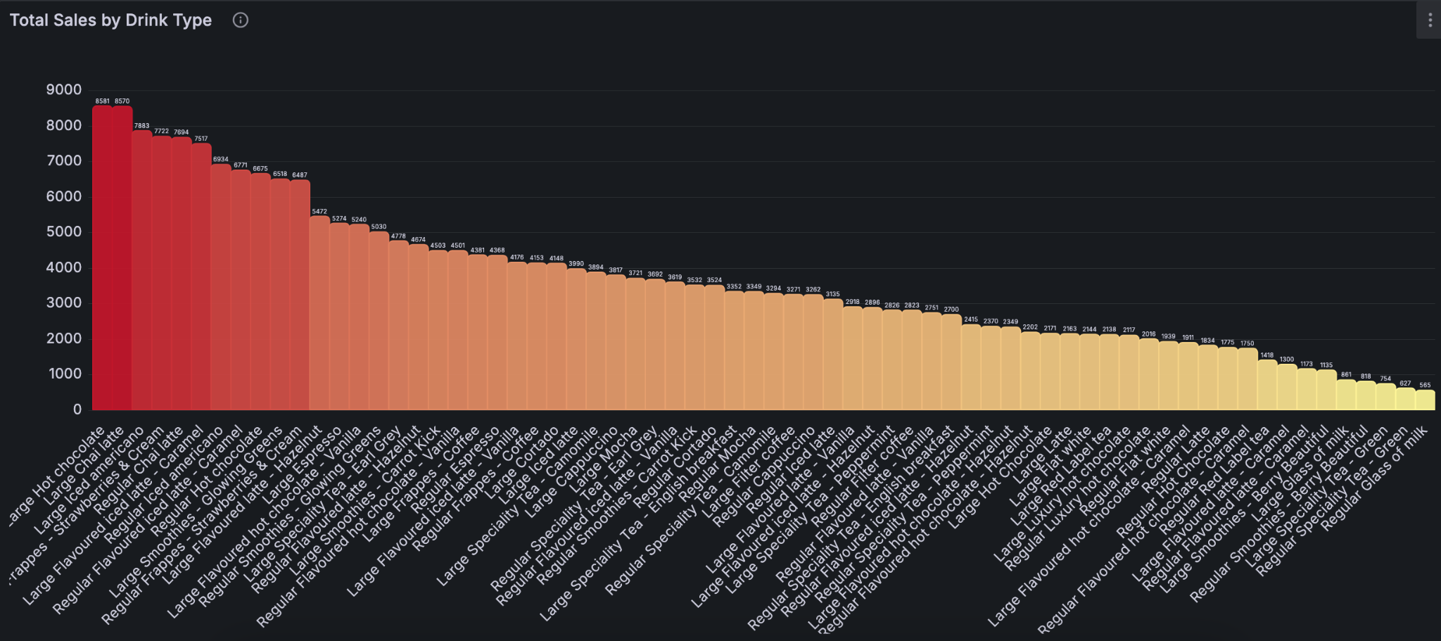
Total Sales By Drink Type
Powered by

Slide 8
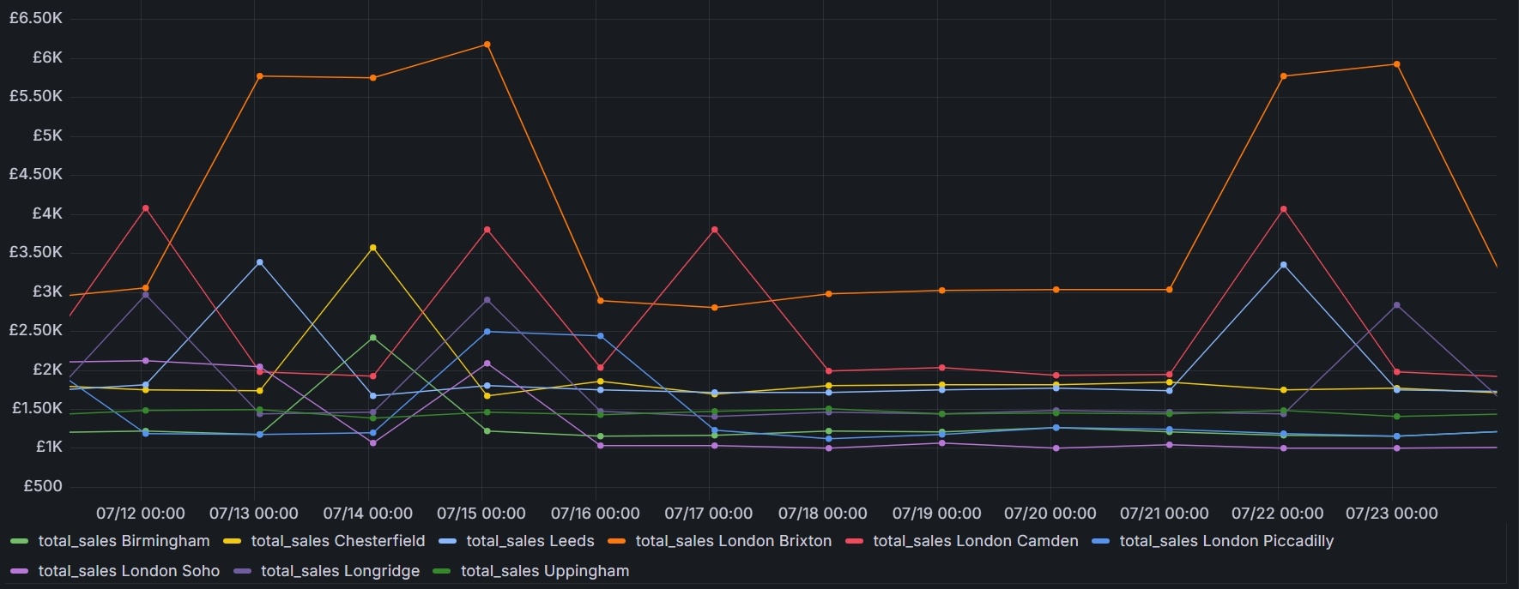
Revenue By Location Over Time
Powered by

Slide 9
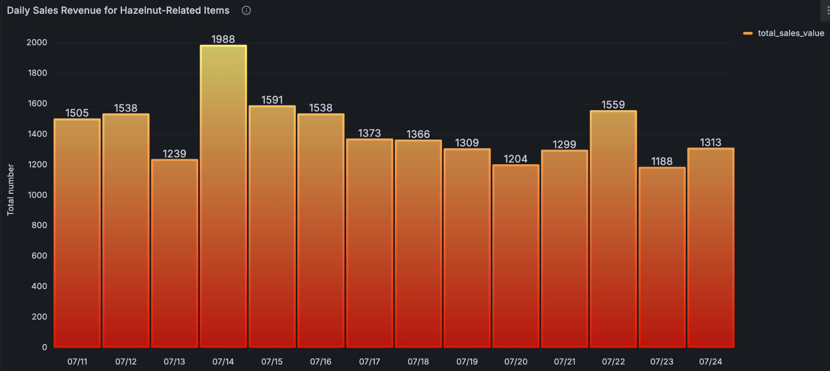
Daily Sales Revenue for Hazelnut-Related Items
Powered by

Slide 10
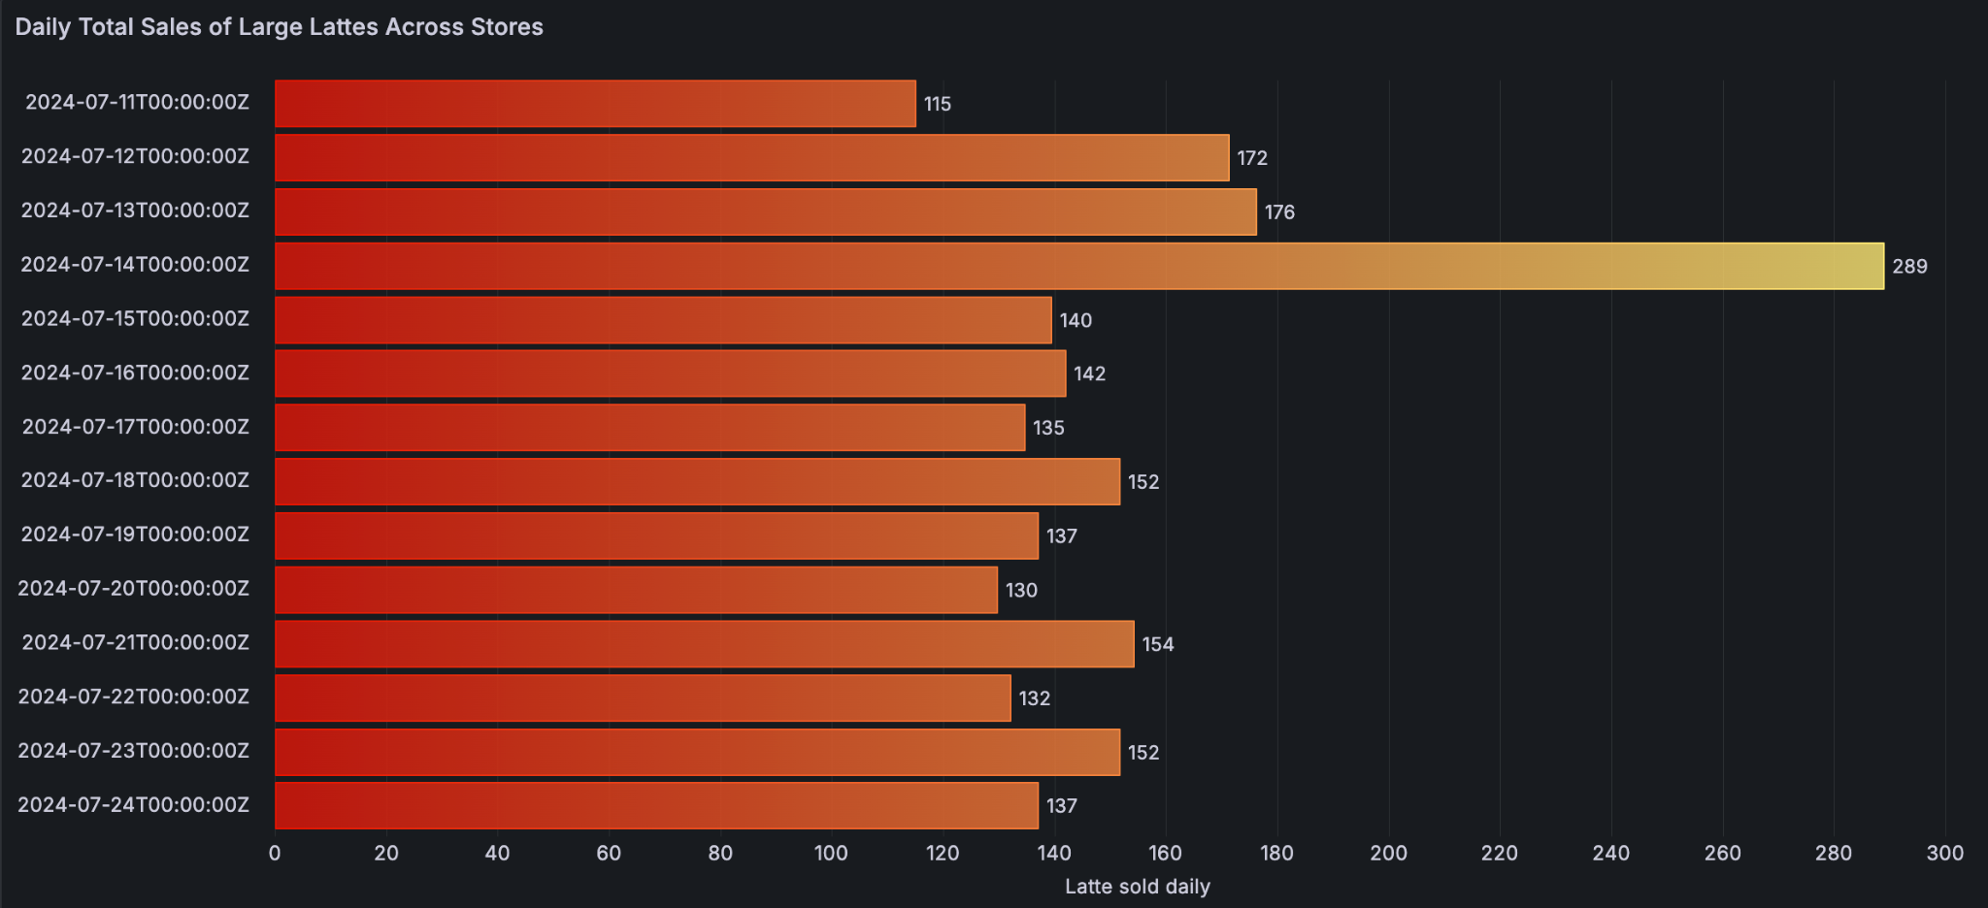
Daily Total Sales of Large Lattes Across Stores
Powered by

Slide 11
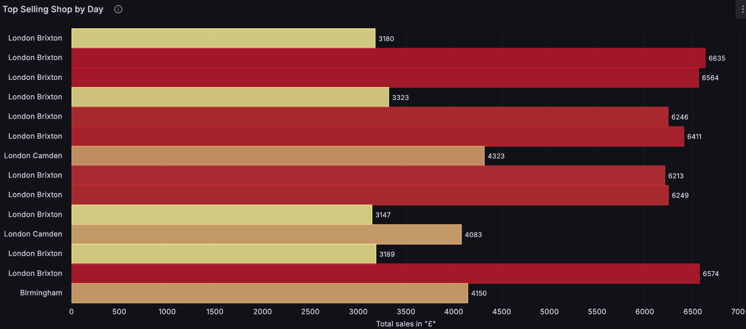
Top Selling Shop By Day
Powered by
11th to 24th July

Slide 12
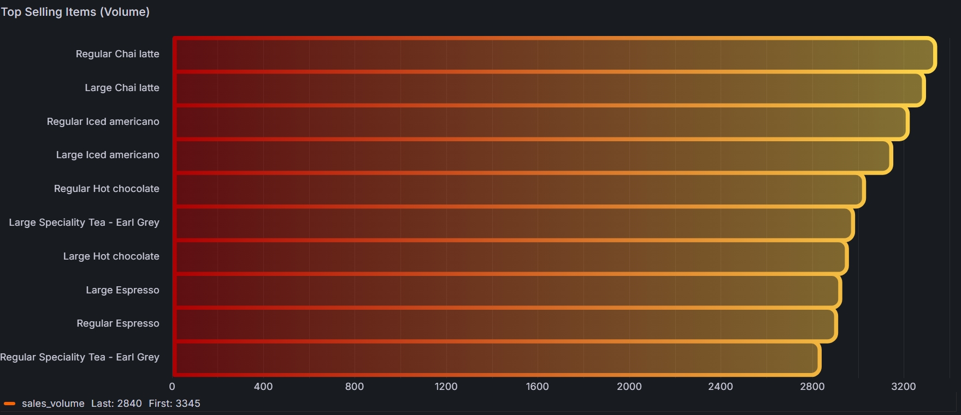
Top Selling Items By Volume
Powered by

Slide 13
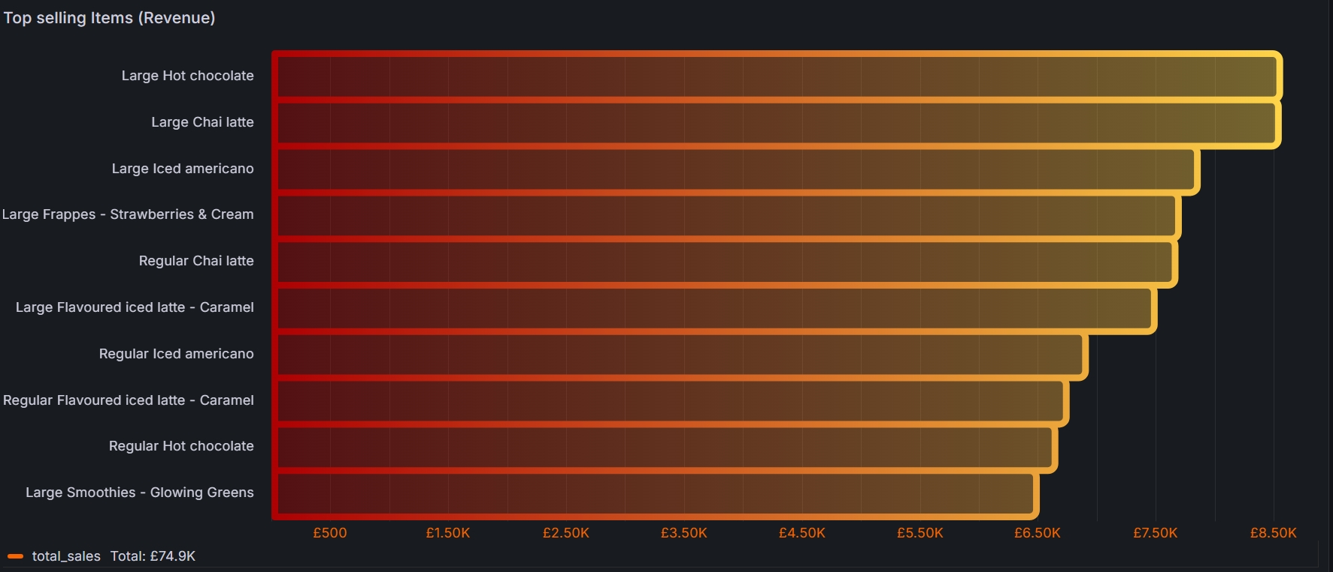
Top Selling Items By Revenue
Powered by

Slide 14
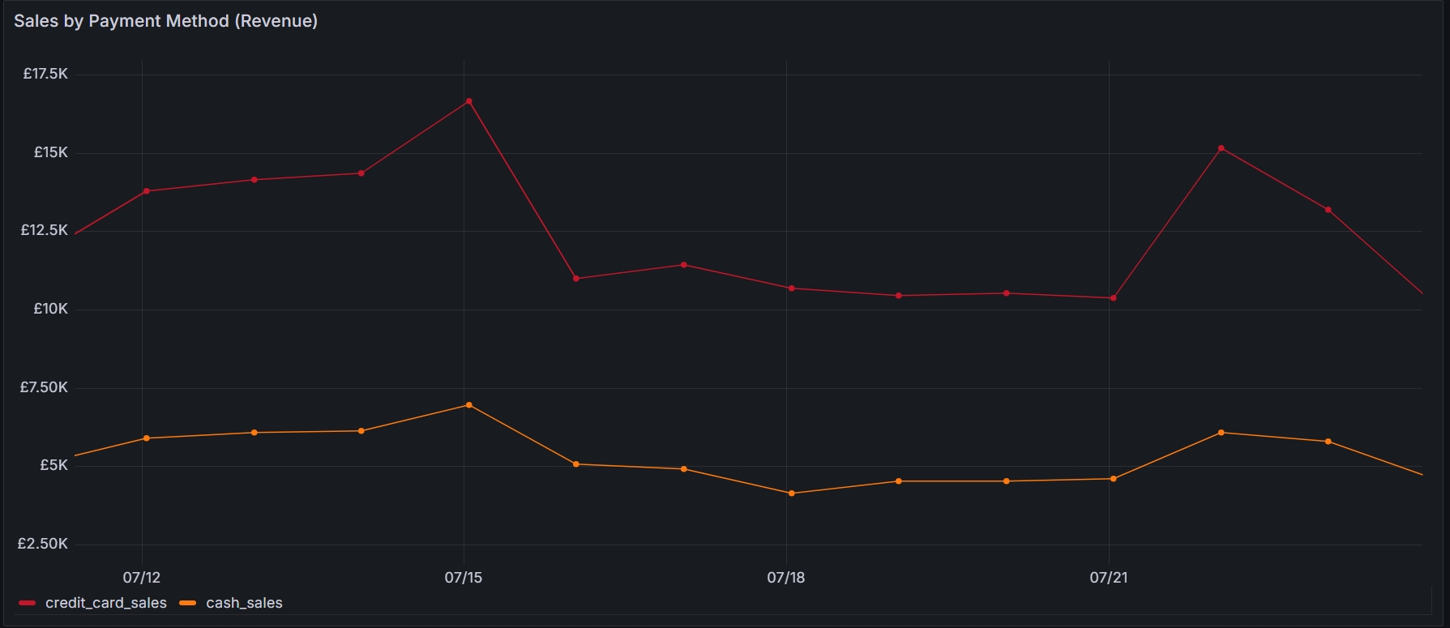
Revenue By Payment Method
Powered by

Slide 15
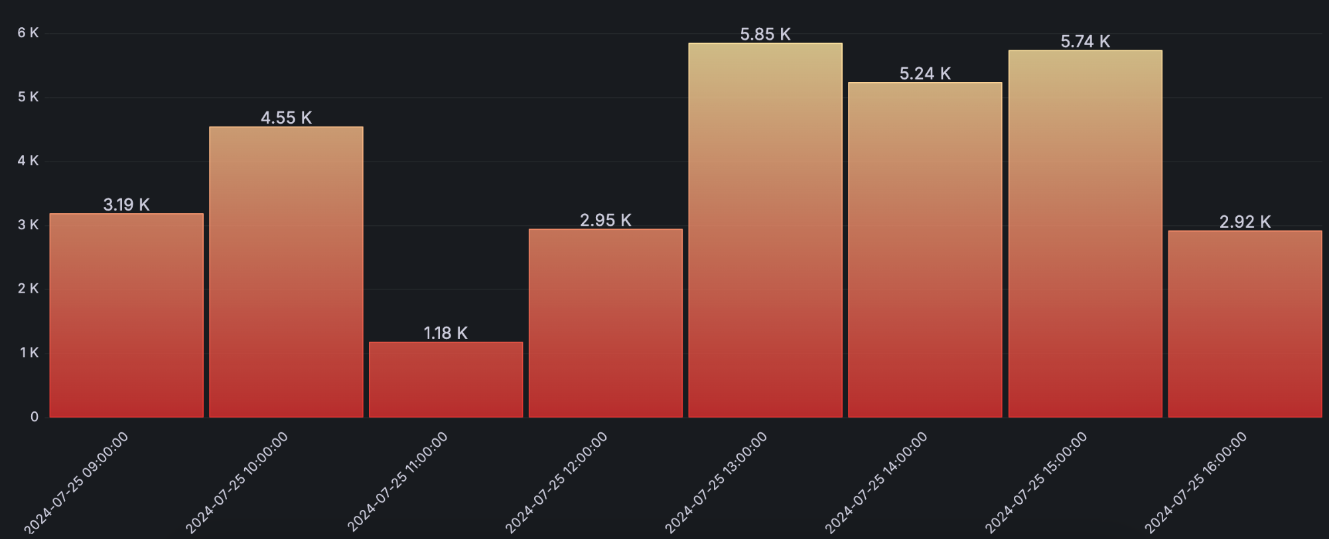
Average Revenue Per Hour Leeds
Powered by

Slide 16
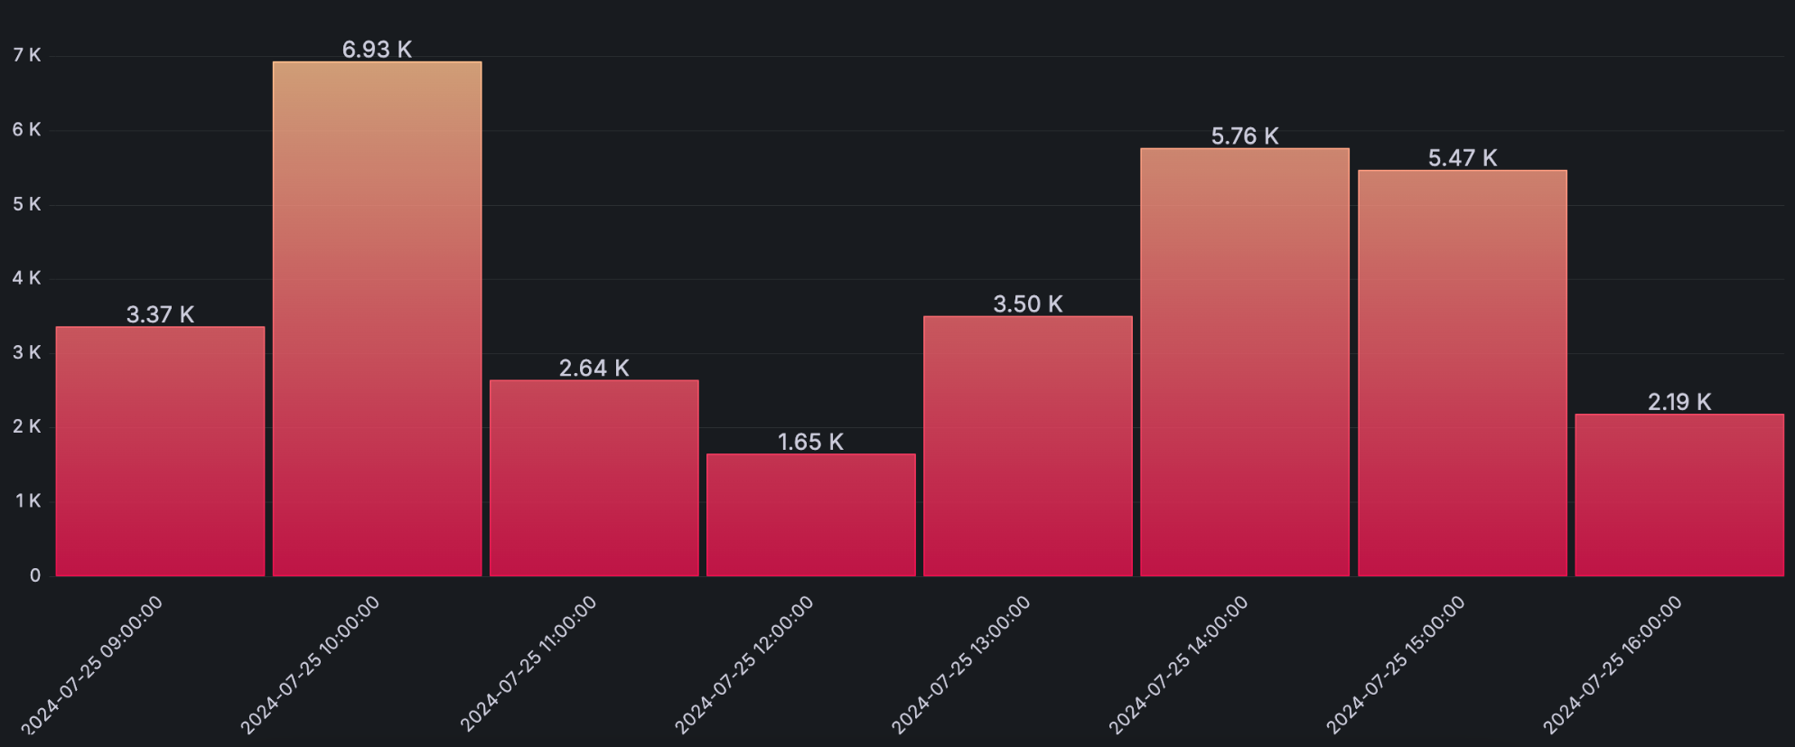
Average Revenue Per Hour Chesterfield
Powered by

Slide 17
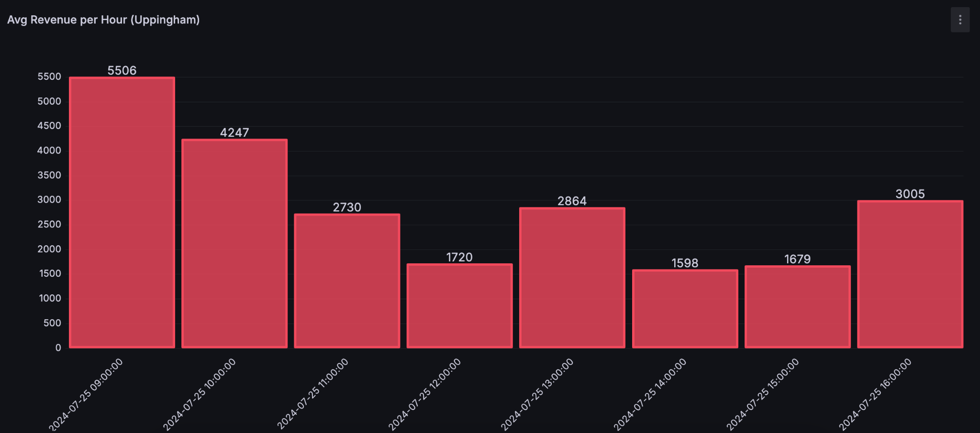
Average Revenue Per Hour Uppingham
Powered by

Slide 18
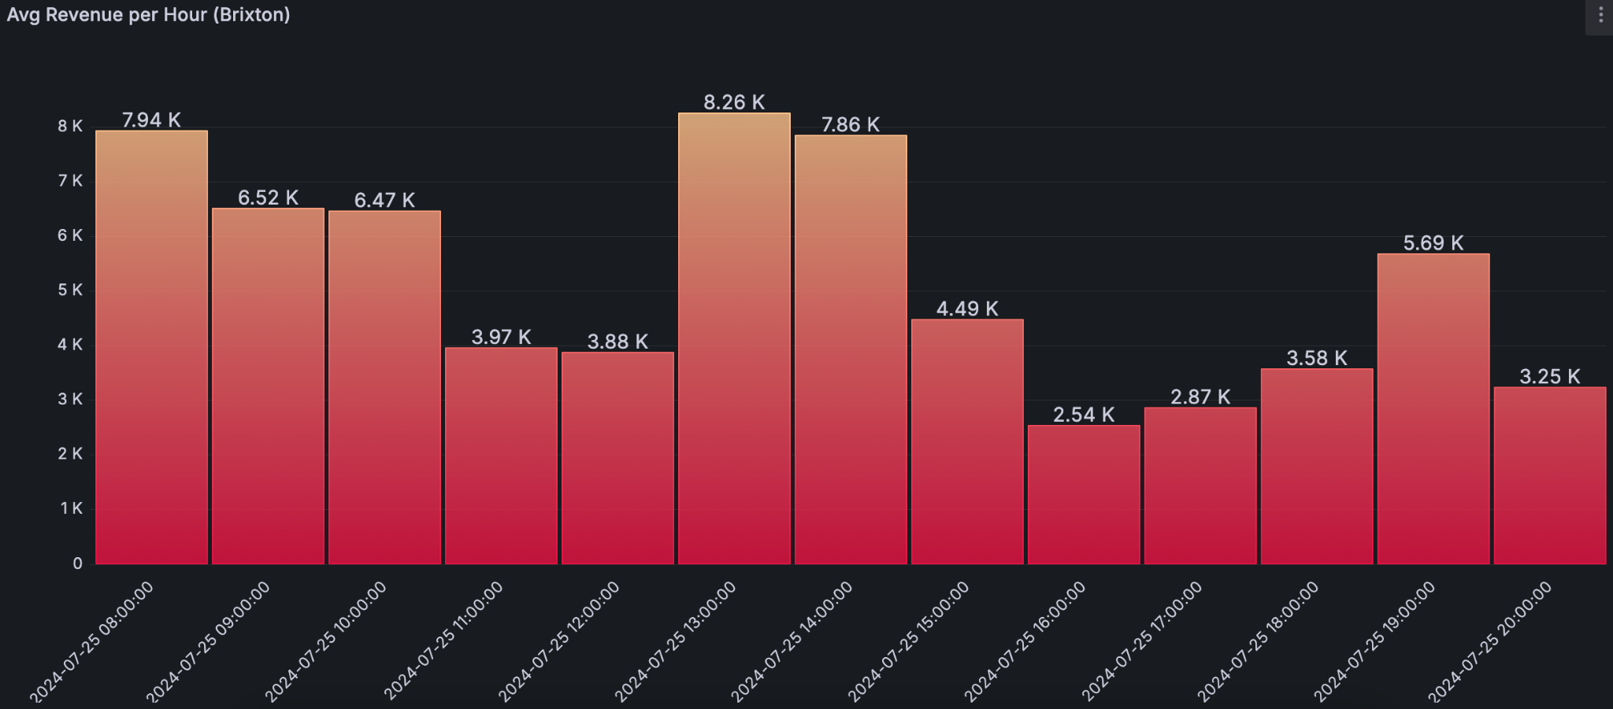
Average Revenue Per Hour Brixton
Powered by

Slide 19
.
The tools we used to get the job done.
Here’s the technical part

Slide 20

Powered by
Data in visual charts and graphs
Importantly, it allows you to see your sales data visuals

Slide 21

Runs our software consistently
Whether it's on our computers during development
OR
In the cloud when it's live

Slide 22

Visual Studio Code
Where our team writes and edits the software code
It's like a digital workspace for coding

Slide 23




Code languages included in the project are

Slide 24


What is Python
Lists
Dictionaries
Lists and Dictionaries
inside each other!

Slide 25

Your Data
And
CSV files

Slide 26

Keeping it all safe in
GitHub

Slide 28

Amazon Web Services
Notes:
AWS - Amazon Web Services. We used Amazon Web Services for our cloud infrastructure. Think of it as a reliable and
scalable platform where we store and process our data securely.

Slide 29

S3 Bucket
SQS - Simple Queue Service
CloudFormation
Lambda
Redshift
Notes:
AWS - Amazon Web Services. We used Amazon Web Services for our cloud infrastructure. Think of it as a reliable and
scalable platform where we store and process our data securely.

Slide 30
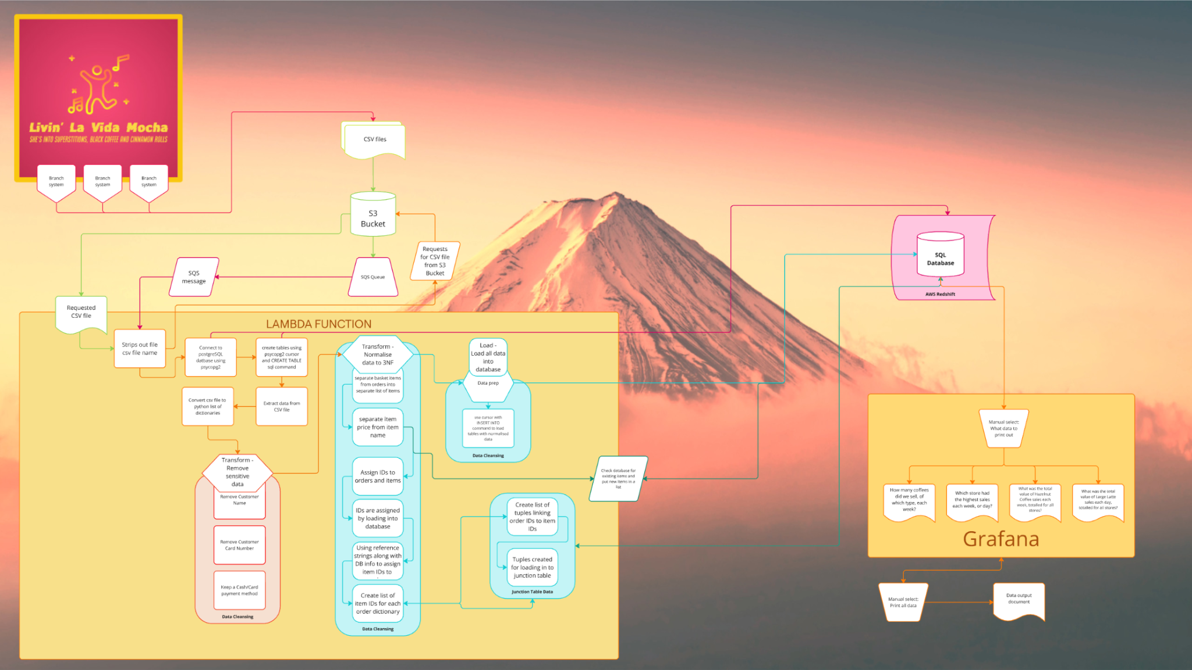

Slide 32


Tracking Project Data
To
Successful Implementation

Slide 33
SOARING DATA SOLUTIONS

